Slide 1
Database Normalization

Slide 2
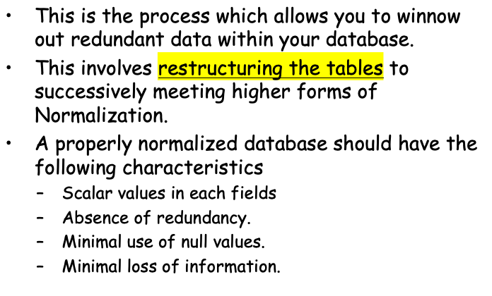
Definition

Slide 3
Levels of Normalization
Levels of normalization based on the amount of redundancy in the database.
Various levels of normalization are:
  First Normal Form (1NF)
  Second Normal Form (2NF)
  Third Normal Form (3NF)
  Boyce-Codd Normal Form (BCNF)
  Fourth Normal Form (4NF)
  Fifth Normal Form (5NF)
  Domain Key Normal Form (DKNF)
Redundancy
Number of Tables
Complexity
Most databases should be 3NF or BCNF in order to avoid the database anomalies.

Slide 4
Levels of Normalization
1NF
2NF
3NF
4NF
5NF
DKNF
Each higher level is a subset of the lower level

Slide 5
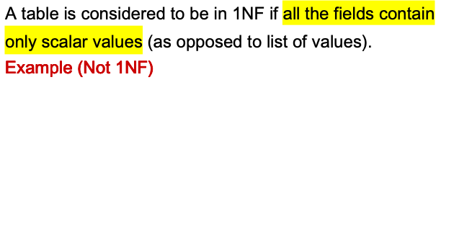
First Normal Form (1NF)
ISBN
Title
AuName
AuPhone
PubName
PubPhone
Price
0-321-32132-1
Balloon
Sleepy, Snoopy, Grumpy
321-321-1111, 232-234-1234, 665-235-6532
Small House
714-000-0000
$34.00
0-55-123456-9
Main Street
Jones, Smith
123-333-3333, 654-223-3455
Small House
714-000-0000
$22.95
0-123-45678-0
Ulysses
Joyce
666-666-6666
Alpha Press
999-999-9999
$34.00
1-22-233700-0
Visual Basic
Roman
444-444-4444
Big House
123-456-7890
$25.00
Author and AuPhone columns are not scalar

Slide 6
1NF - Decomposition
Place all items that appear in the repeating group in a new table
Designate a primary key for each new table produced.
Duplicate in the new table the primary key of the table from which the repeating group was extracted or vice versa.
Example (1NF)
ISBN
AuName
AuPhone
0-321-32132-1
Sleepy
321-321-1111
0-321-32132-1
Snoopy
232-234-1234
ISBN
Title
PubName
PubPhone
Price
0-321-32132-1
Grumpy
665-235-6532
0-321-32132-1
Balloon
Small House
714-000-0000
$34.00
0-55-123456-9
Jones
123-333-3333
0-55-123456-9
Main Street
Small House
714-000-0000
$22.95
0-55-123456-9
Smith
654-223-3455
0-123-45678-0
Ulysses
Alpha Press
999-999-9999
$34.00
0-123-45678-0
Joyce
666-666-6666
1-22-233700-0
Visual Basic
Big House
123-456-7890
$25.00
1-22-233700-0
Roman
444-444-4444

Slide 7
Functional Dependencies
If one set of attributes in a table determines another set of attributes in the table, then the second set of attributes is said to be functionally dependent on the first set of attributes.
Example 1
ISBN
Title
Price
Table Scheme: {ISBN, Title, Price}
Functional Dependencies: {ISBN} → {Title}
{ISBN} → {Price}
0-321-32132-1
Balloon
$34.00
0-55-123456-9
Main Street
$22.95
0-123-45678-0
Ulysses
$34.00
1-22-233700-0
Visual Basic
$25.00

Slide 8
Functional Dependencies
Example 2
Table Scheme: {PubID, PubName, PubPhone}
Functional Dependencies: {PubId} → {PubPhone}
{PubId} → {PubName}
{PubName, PubPhone} → {PubID}
PubID
PubName
PubPhone
1
Big House
999-999-9999
2
Small House
123-456-7890
3
Alpha Press
111-111-1111
Example 3
AuID
AuName
AuPhone
Table Scheme: {AuID, AuName, AuPhone}
Functional Dependencies: {AuId} → {AuPhone}
{AuId} → {AuName}
{AuName, AuPhone} → {AuID}
1
Sleepy
321-321-1111
2
Snoopy
232-234-1234
3
Grumpy
665-235-6532
4
Jones
123-333-3333
5
Smith
654-223-3455
6
Joyce
666-666-6666
7
Roman
444-444-4444

Slide 9
FD – Example
Database to track reviews of papers submitted to an academic conference. Prospective authors submit papers for review and possible acceptance in the published conference proceedings. Details of the entities
  Author information includes a unique author number, a name, a mailing address, and a unique (optional) email address.
  Paper information includes the primary author, the paper number, the title, the abstract, and review status (pending, accepted,rejected)
  Reviewer information includes the reviewer number, the name, the mailing address, and a unique (optional) email address
  A completed review includes the reviewer number, the date, the paper number, comments to the authors, comments to the program chairperson, and ratings (overall, originality, correctness, style, clarity)

Slide 10
FD – Example
Functional Dependencies
  AuthNo → AuthName, AuthEmail, AuthAddress
  AuthEmail → AuthNo
  PaperNo → Primary-AuthNo, Title, Abstract, Status
  RevNo → RevName, RevEmail, RevAddress
  RevEmail → RevNo
  RevNo, PaperNo → AuthComm, Prog-Comm, Date, Rating1, Rating2, Rating3, Rating4, Rating5

Slide 11
Second Normal Form (2NF)
For a table to be in 2NF, there are two requirements
  The database is in first normal form
  All nonkey attributes in the table must be functionally dependent on the entire primary key
Note: Remember that we are dealing with non-key attributes
Example 1 (Not 2NF)
Scheme → {Title, PubId, AuId, Price, AuAddress}
  Key → {Title, PubId, AuId}
  {Title, PubId, AuID} → {Price}
  {AuID} → {AuAddress}
  AuAddress does not belong to a key
  AuAddress functionally depends on AuId which is a subset of a key

Slide 12
Second Normal Form (2NF)
I like the example with City, Street.
Example 2 (Not 2NF)
Scheme → {City, Street, HouseNumber, HouseColor, CityPopulation}
  key → {City, Street, HouseNumber}
  {City, Street, HouseNumber} → {HouseColor}
  {City} → {CityPopulation}
  CityPopulation does not belong to any key.
  CityPopulation is functionally dependent on the City which is a proper subset of the key
Example 3 (Not 2NF)
Scheme → {studio, movie, budget, studio_city}
  Key → {studio, movie}
  {studio, movie} → {budget}
  {studio} → {studio_city}
  studio_city is not a part of a key
  studio_city functionally depends on studio which is a proper subset of the key

Slide 13
2NF - Decomposition
If a data item is fully functionally dependent on only a part of the primary key, move that data item and that part of the primary key to a new table.
If other data items are functionally dependent on the same part of the key, place them in the new table also.
Make the partial primary key copied from the original table the primary key for the new table. Place all items that appear in the repeating group in a new table
Example 1 (Convert to 2NF)
  Old Scheme → {Title, PubId, AuId, Price, AuAddress}
  New Scheme → {Title, PubId, AuId, Price}
  New Scheme → {AuId, AuAddress}

Slide 14
2NF - Decomposition
Example 2 (Convert to 2NF)
  Old Scheme → {Studio, Movie, Budget, StudioCity}
  New Scheme → {Movie, Studio, Budget}
  New Scheme → {Studio, City}
Example 3 (Convert to 2NF)
  Old Scheme → {City, Street, HouseNumber, HouseColor, CityPopulation}
  New Scheme → {City, Street, HouseNumber, HouseColor}
  New Scheme → {City, CityPopulation}
I like the 3rd example.

Slide 15
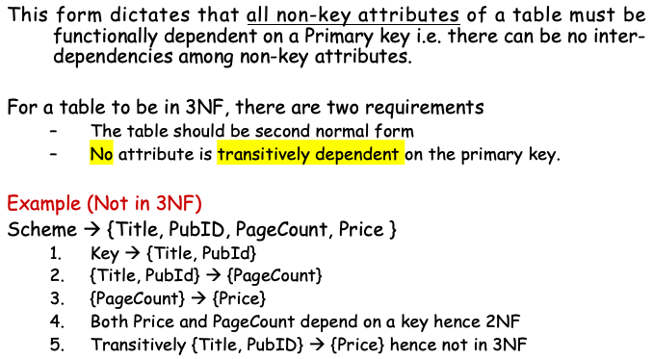
Third Normal Form (3NF)

Slide 16
Transitive Depedency
Tab1
  A – Key Column
  B
  C
  D
D->C
C->A
D is transitively dependent on A

Slide 17
Third Normal Form (3NF)
Example 2 (Not in 3NF)
Scheme → {Studio, StudioCity, CityTemp}
  Primary Key → {Studio}
  {Studio} → {StudioCity}
  {StudioCity} → {CityTemp}
  {Studio} → {CityTemp}
  Both StudioCity and CityTemp depend on the entire key hence 2NF
  CityTemp transitively depends on Studio hence violates 3NF
Example 3 (Not in 3NF)
Scheme → {BuildingID, Contractor, Fee}
  Primary Key → {BuildingID}
  {BuildingID} → {Contractor}
  {Contractor} → {Fee}
  {BuildingID} → {Fee}
  Fee transitively depends on the BuildingID
  Both Contractor and Fee depend on the entire key hence 2NF
BuildingID
Contractor
Fee
100
Randolph
1200
150
Ingersoll
1100
200
Randolph
1200
250
Pitkin
1100
300
Randolph
1200

Slide 18
3NF - Decomposition
Move all items involved in transitive dependencies to a new entity.
Identify a primary key for the new entity.
Place the primary key for the new entity as a foreign key on the original entity.
Example 1 (Convert to 3NF)
  Old Scheme → {Title, PubID, PageCount, Price }
  New Scheme → {PubID, PageCount, Price}
  New Scheme → {Title, PubID, PageCount}

Slide 19
3NF - Decomposition
Example 2 (Convert to 3NF)
  Old Scheme → {Studio, StudioCity, CityTemp}
  New Scheme → {Studio, StudioCity}
  New Scheme → {StudioCity, CityTemp}
Example 3 (Convert to 3NF)
  Old Scheme → {BuildingID, Contractor, Fee}
  New Scheme → {BuildingID, Contractor}
  New Scheme → {Contractor, Fee}
BuildingID
Contractor
Contractor
Fee
100
Randolph
Randolph
1200
150
Ingersoll
Ingersoll
1100
200
Randolph
Pitkin
1100
250
Pitkin
300
Randolph

Slide 20
Boyce-Codd Normal Form
(BCNF)

Slide 21
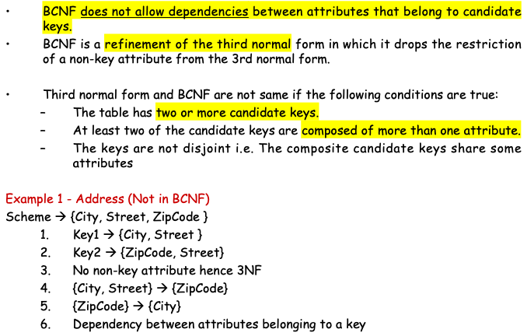
Boyce-Codd Normal Form (BCNF)

Slide 22
Natural Key vs Surrogate Key
A natural key is a single column or set of columns that uniquely identifies a single record in a table, where the key columns are made up of real data. When I say “real data” I mean data that has meaning and occurs naturally in the world of data. A natural key is a column value that has a relationship with the rest of the column values in a given data record. Here are some examples of natural keys values: Social Security Number, ISBN, and TaxId.
A surrogate key like a natural key is a column that uniquely identifies a single record in a table. But this is where the similarity stops. Surrogate keys are similar to surrogate mothers. They are keys that don’t have a natural relationship with the rest of the columns in a table. The surrogate key is just a value that is generated and then stored with the rest of the columns in a record. The key value is typically generated at run time right before the record is inserted into a table. It is sometimes also referred to as a dumb key, because there is no meaning associated with the value. Surrogate keys are commonly a numeric number.

Slide 23
Boyce Codd Normal Form (BCNF)
Example 2 - Movie (Not in BCNF)
Scheme → {MovieTitle, MovieID, PersonName, Role, Payment }
  Key1 → {MovieTitle, PersonName}
  Key2 → {MovieID, PersonName}
  Both role and payment functionally depend on both candidate keys thus 3NF
  {MovieID} → {MovieTitle}
  Dependency between MovieID & MovieTitle Violates BCNF
Example 3 - Consulting (Not in BCNF)
Scheme → {Client, Problem, Consultant}
  Key1 → {Client, Problem}
  Key2 → {Client, Consultant}
  No non-key attribute hence 3NF
  {Client, Problem} → {Consultant}
  {Client, Consultant} → {Problem}
  Dependency between attributess belonging to keys violates BCNF

Slide 24
BCNF - Decomposition
Place the two candidate primary keys in separate entities
Place each of the remaining data items in one of the resulting entities according to its dependency on the primary key.
Example 1 (Convert to BCNF)
  Old Scheme → {City, Street, ZipCode }
  New Scheme1 → {ZipCode, Street}
  New Scheme2 → {City, Street}
Loss of relation {ZipCode} → {City}
  Alternate New Scheme1 → {ZipCode, Street }
  Alternate New Scheme2 → {ZipCode, City}

Slide 25
Decomposition – Loss of Information
If decomposition does not cause any loss of information it is called a lossless decomposition.
If a decomposition does not cause any dependencies to be lost it is called a dependency-preserving decomposition.
Any table scheme can be decomposed in a lossless way into a collection of smaller schemas that are in BCNF form. However the dependency preservation is not guaranteed.
Any table can be decomposed in a lossless way into 3rd normal form that also preserves the dependencies.
  3NF may be better than BCNF in some cases
Use your own judgment when decomposing schemas

Slide 26
BCNF - Decomposition
Example 2 (Convert to BCNF)
  Old Scheme → {MovieTitle, MovieID, PersonName, Role, Payment }
  New Scheme → {MovieID, PersonName, Role, Payment}
  New Scheme → {MovieTitle, PersonName}
Loss of relation {MovieID} → {MovieTitle}
  New Scheme → {MovieID, PersonName, Role, Payment}
  New Scheme → {MovieID, MovieTitle}
We got the {MovieID} → {MovieTitle} relationship back
Example 3 (Convert to BCNF)
  Old Scheme → {Client, Problem, Consultant}
  New Scheme → {Client, Consultant}
  New Scheme → {Client, Problem}

Slide 27
Fourth Normal Form (4NF)
Fourth normal form eliminates independent many-to-one relationships between columns.
To be in Fourth Normal Form,
  a relation must first be in Boyce-Codd Normal Form.
  a given relation may not contain more than one multi-valued attribute.
Example (Not in 4NF)
  Scheme → {MovieName, ScreeningCity, Genre)
  Primary Key: {MovieName, ScreeningCity, Genre)
  All columns are a part of the only candidate key, hence BCNF
  Many Movies can have the same Genre
  Many Cities can have the same movie
  Violates 4NF
Movie
ScreeningCity
Genre
Hard Code
Los Angles
Comedy
Hard Code
New York
Comedy
Bill Durham
Santa Cruz
Drama
Bill Durham
Durham
Drama
The Code Warrier
New York
Horror

Slide 28
Fourth Normal Form (4NF)
Example 2 (Not in 4NF)
Scheme → {Manager, Child, Employee}
  Primary Key → {Manager, Child, Employee}
  Each manager can have more than one child
  Each manager can supervise more than one employee
  4NF Violated
Example 3 (Not in 4NF)
Scheme → {Employee, Skill, ForeignLanguage}
  Primary Key → {Employee, Skill, Language }
  Each employee can speak multiple languages
  Each employee can have multiple skills
  Thus violates 4NF
Manager
Child
Employee
Jim
Beth
Alice
Mary
Bob
Jane
Mary
NULL
Adam
Employee
Skill
Language
1234
Cooking
French
1234
Cooking
German
1453
Carpentry
Spanish
1453
Cooking
Spanish
2345
Cooking
Spanish

Slide 29
4NF - Decomposition
Move the two multi-valued relations to separate tables
Identify a primary key for each of the new entity.
Example 1 (Convert to 4NF)
  Old Scheme → {MovieName, ScreeningCity, Genre}
  New Scheme → {MovieName, ScreeningCity}
  New Scheme → {MovieName, Genre}
Movie
Genre
Movie
ScreeningCity
Hard Code
Comedy
Hard Code
Los Angles
Bill Durham
Drama
Hard Code
New York
The Code Warrier
Horror
Bill Durham
Santa Cruz
Bill Durham
Durham
The Code Warrier
New York

Slide 30
4NF - Decomposition
Example 2 (Convert to 4NF)
  Old Scheme → {Manager, Child, Employee}
  New Scheme → {Manager, Child}
  New Scheme → {Manager, Employee}
Example 3 (Convert to 4NF)
  Old Scheme → {Employee, Skill, ForeignLanguage}
  New Scheme → {Employee, Skill}
  New Scheme → {Employee, ForeignLanguage}
Manager
Child
Manager
Employee
Jim
Beth
Jim
Alice
Mary
Bob
Mary
Jane
Mary
Adam
Employee
Skill
Employee
Language
1234
Cooking
1234
French
1453
Carpentry
1234
German
1453
Cooking
1453
Spanish
2345
Cooking
2345
Spanish

Slide 31
Fifth Normal Form (5NF)
Fifth normal form is satisfied when all tables are broken into as many tables as possible in order to avoid redundancy. Once it is in fifth normal form it cannot be broken into smaller relations without changing the facts or the meaning.

Slide 32
Domain Key Normal Form (DKNF)
The relation is in DKNF when there can be no insertion or deletion anomalies in the database.

